Slide 2

0
4
Lesson 04
Counting IV-Combination 2

Slide 3
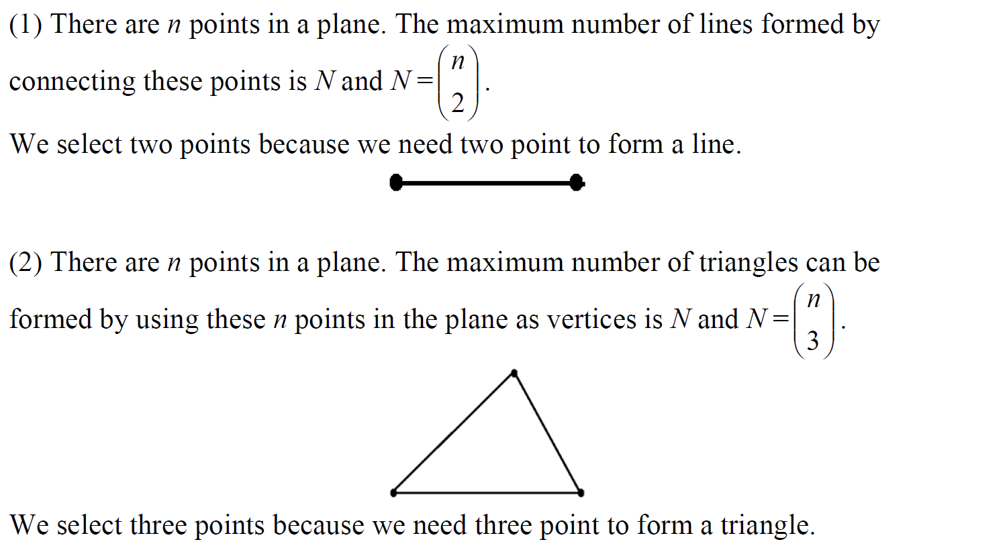
Lead in

Slide 4
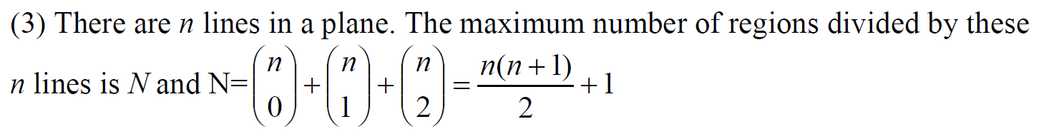
Lead in

Slide 5
Part 1
Counting the number of points

Slide 6
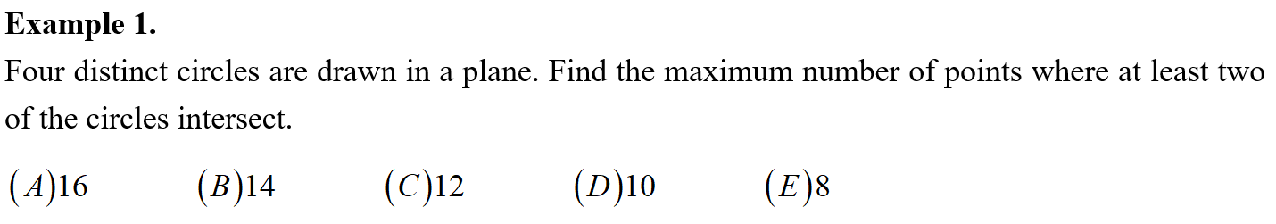
Example

Slide 7
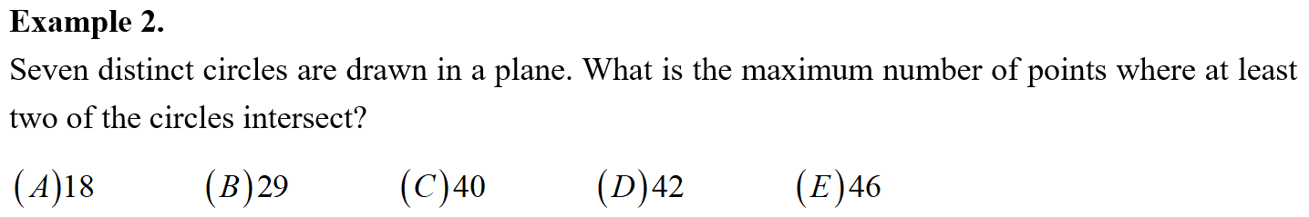
Example

Slide 8
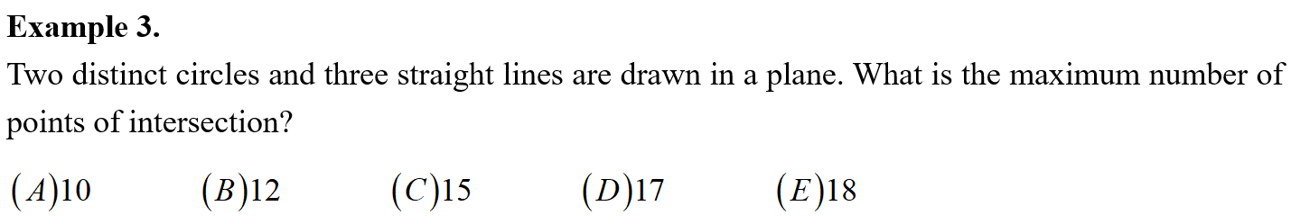
Example

Slide 9
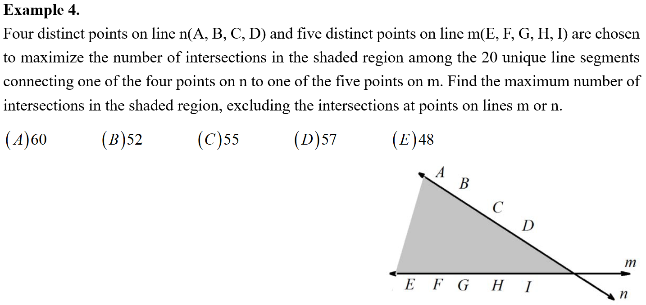
Example

Slide 10
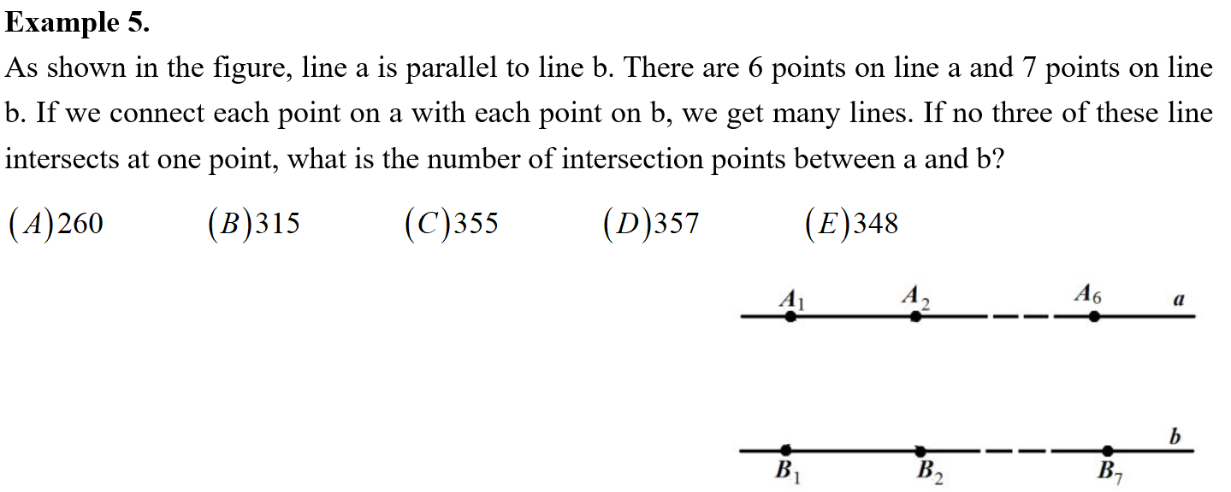
Example

Slide 11
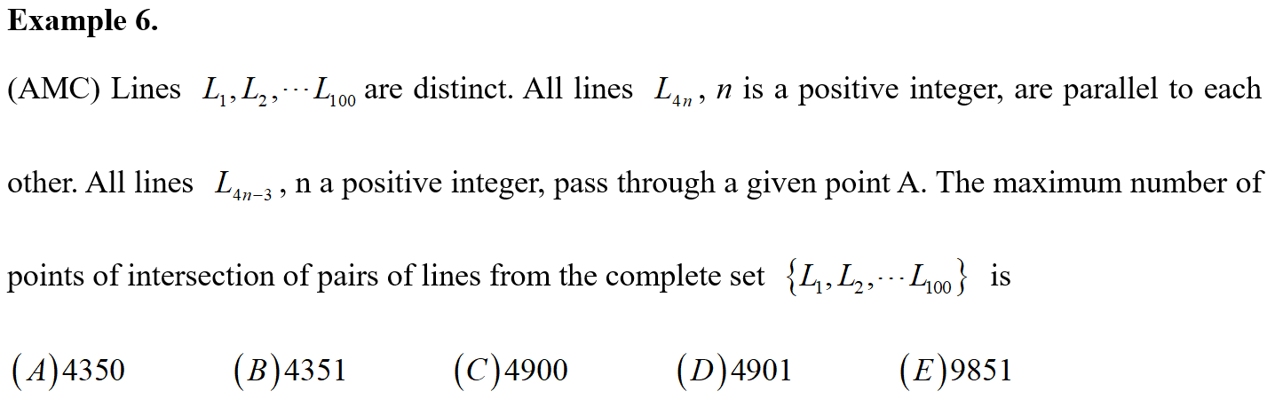
Example

Slide 12
Part 2
Counting how many rectangles

Slide 13
Lead in

Slide 14
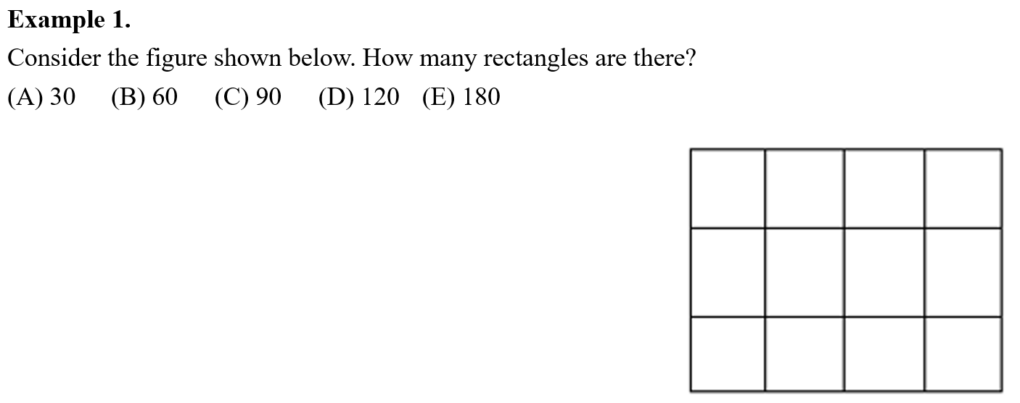
Example

Slide 15
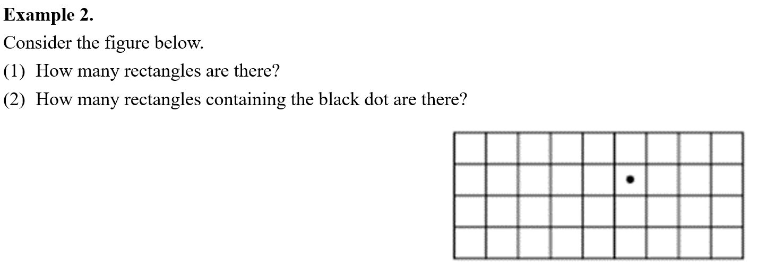

Example

Slide 16
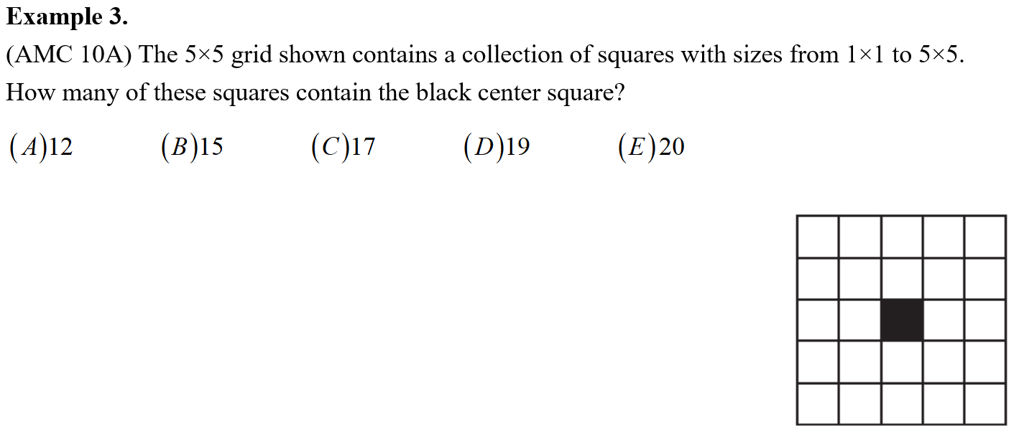
Example

Slide 17
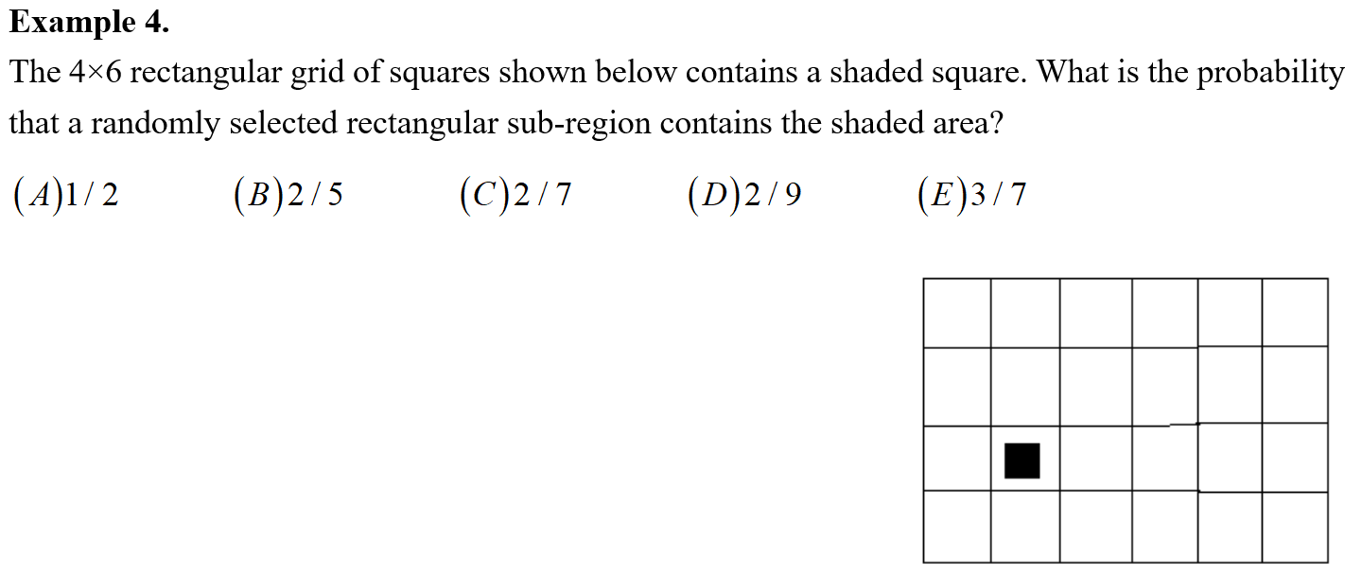
Example

Slide 18
Part 3
Counting the number of polygons

Slide 19
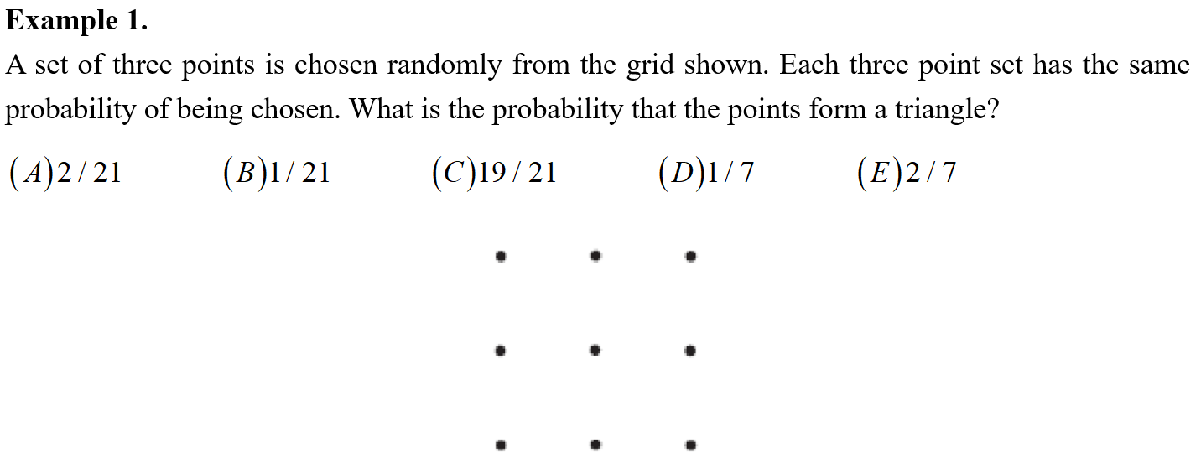
Example

Slide 20
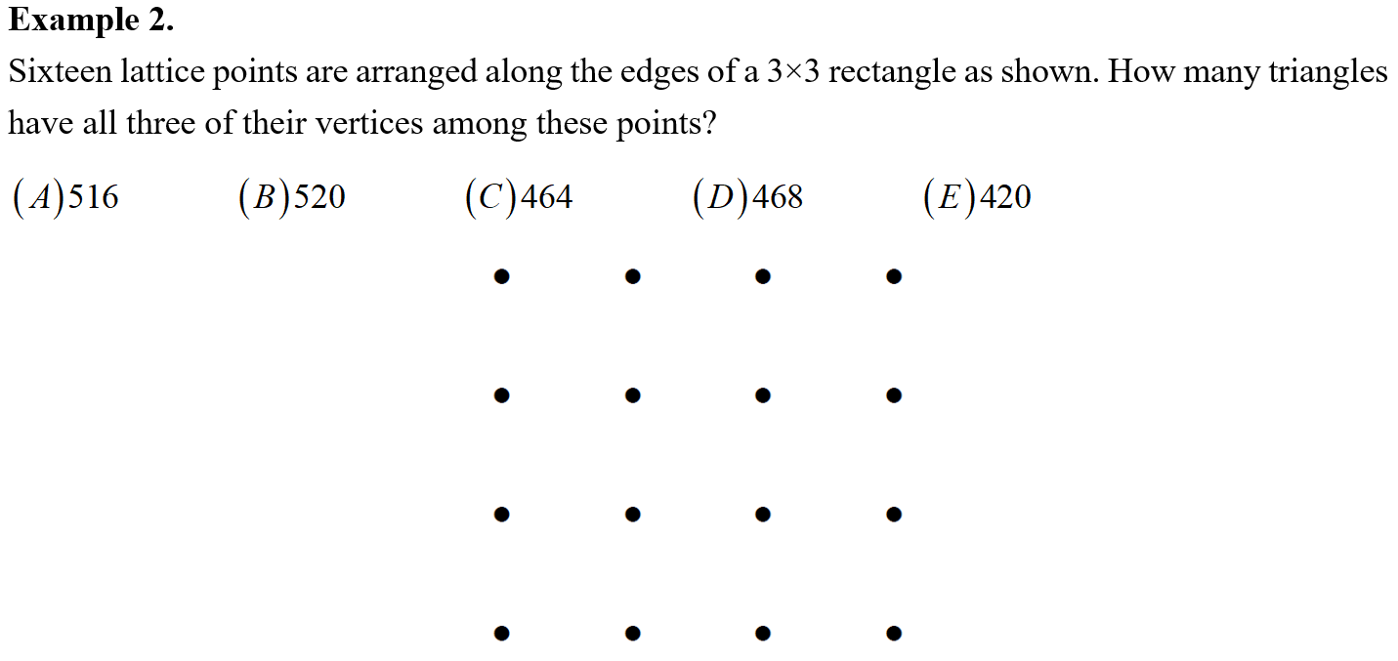
Example

Slide 21
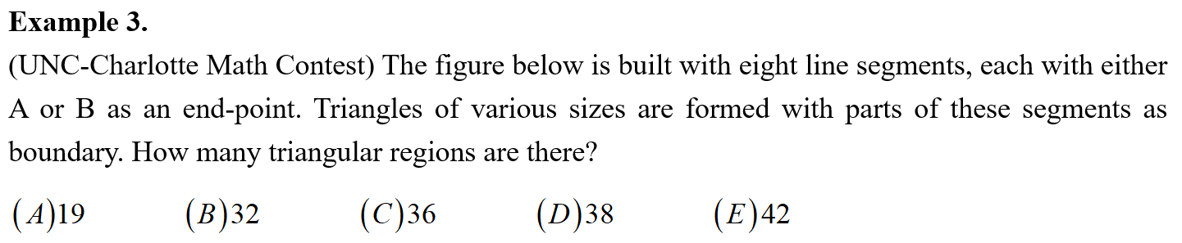
Example

Slide 22
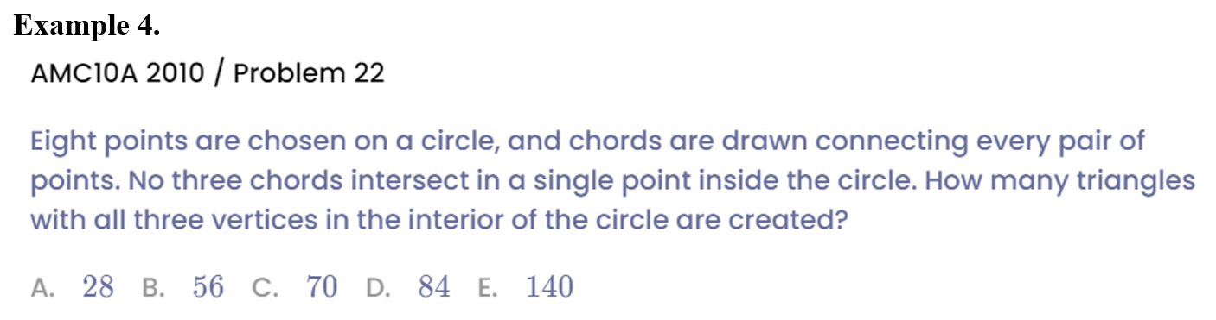
Example

Slide 23
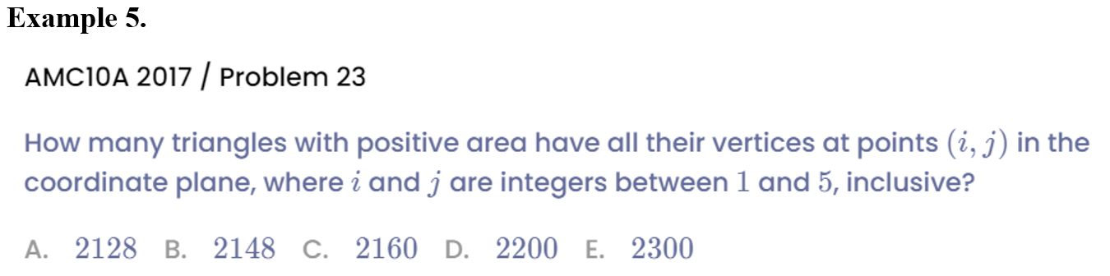
Example

Slide 24
Part 4
Comprehensive combination

Slide 25
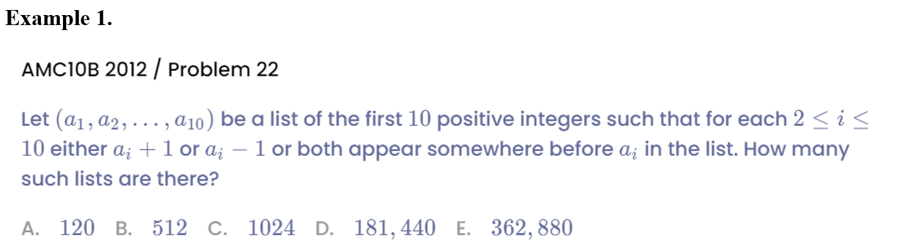
Example

Slide 26
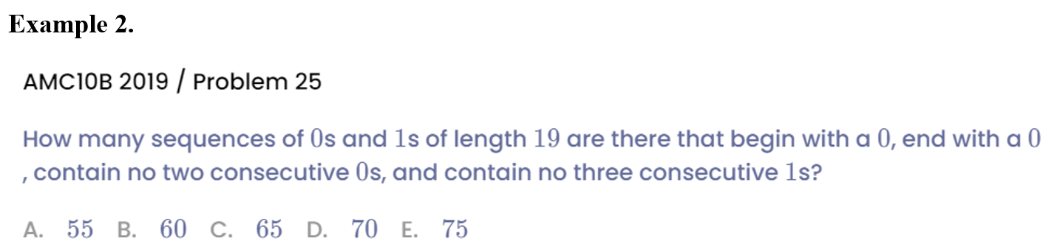
Example

Slide 27
See You Next Time!

